Slide 1






Honolulu, Hawaii, March 5, 2012
Marine debris
from the tsunami of March 11, 2011:
one year after the disaster
Nikolai Maximenko and Jan Hafner
Media contact: Gisela Speidel
International Pacific Research Center
School of Ocean and Earth Science and Technology
University of Hawaii at Manoa

Slide 2
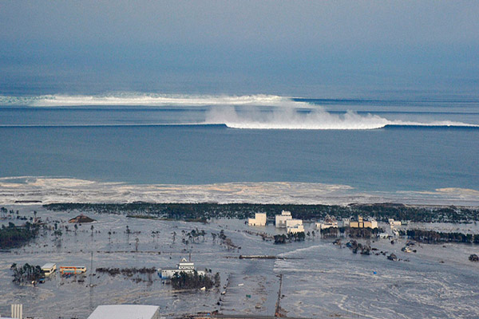
March 11, 2011 tsunami in Japan
Tsunami generated up to 25 million tons of debris, including 4-8 million tons of debris washed into the ocean

Slide 3
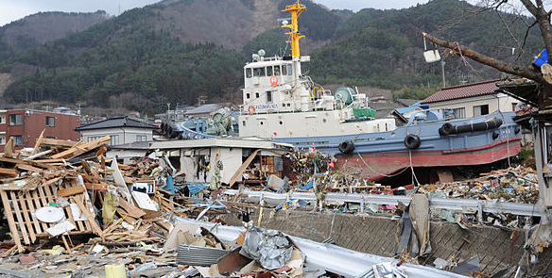
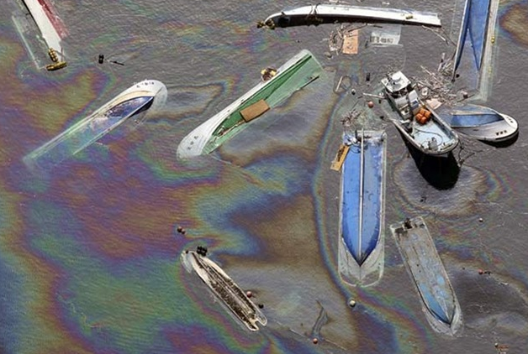
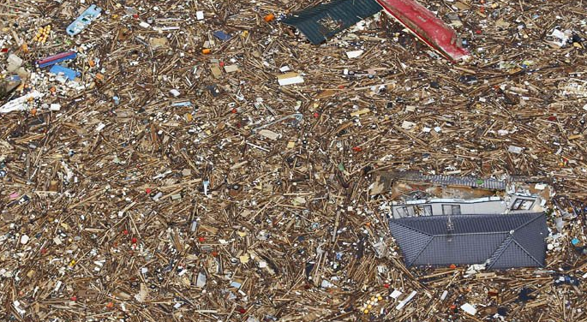
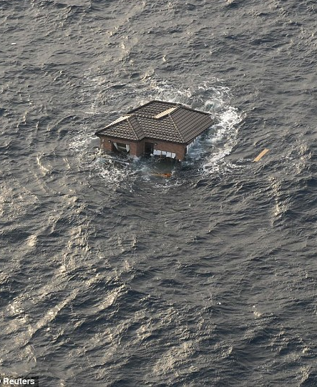
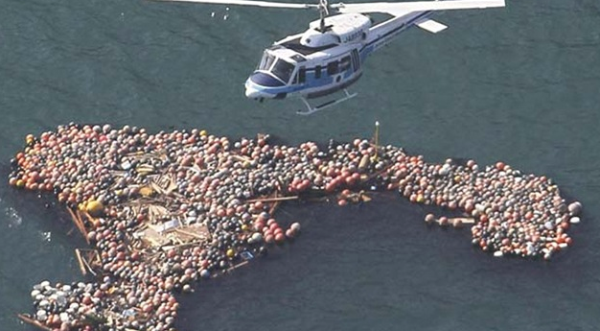
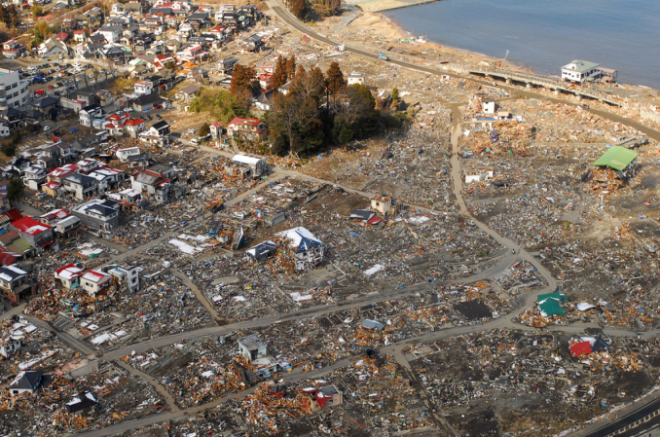
Composition of tsunami debris
Source: Reuters

Slide 4
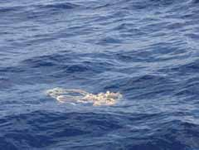
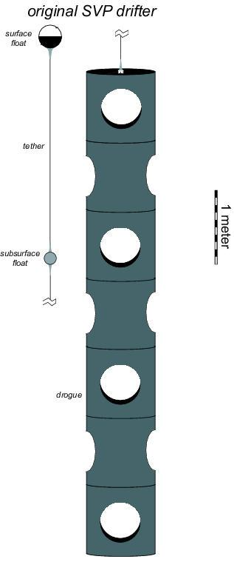
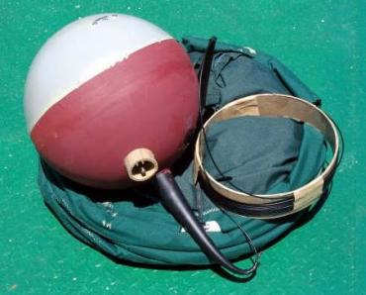
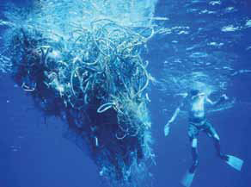
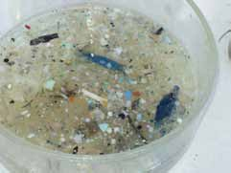
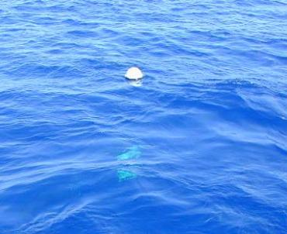
Use of drifting buoys to study pathways of marine debris
There are ~15,000
trajectories,
collected since 1979

Slide 5
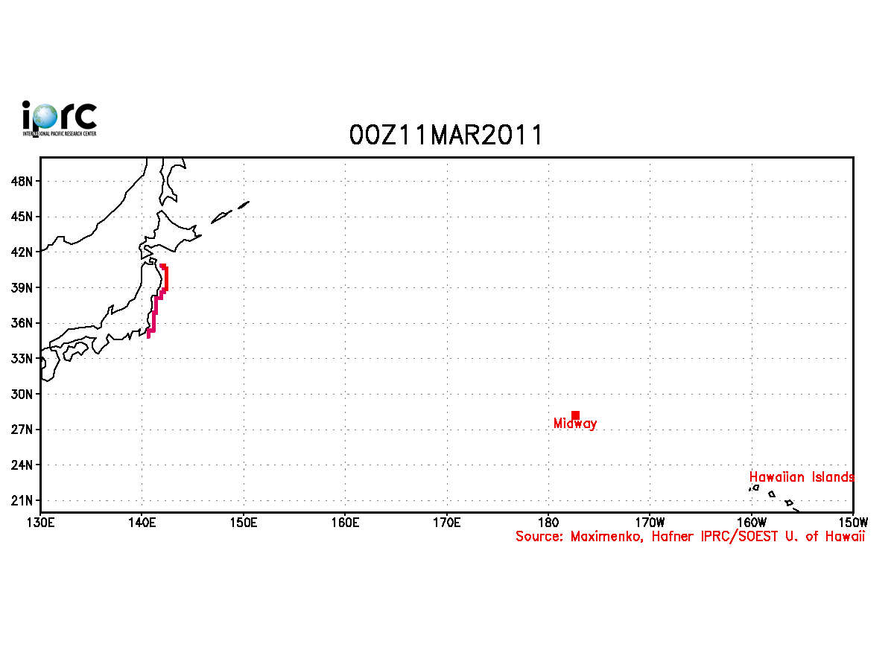
Motion of tsunami debris in the SCUD model

Slide 6
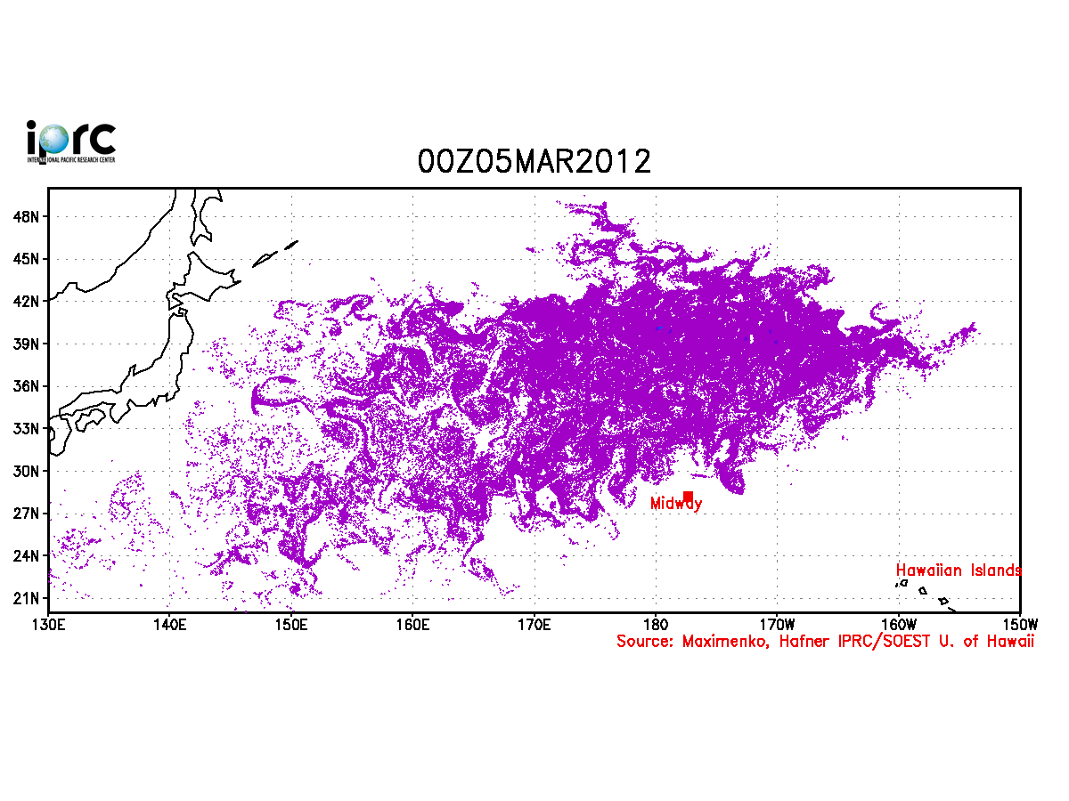
Daily public updates are available
at http://iprc.soest.hawaii.edu/users/hafner/PUBLIC/TSUNAMI_DEBRIS
Notes:
Add web link
6

Slide 7
Daily public updates are available
at http://iprc.soest.hawaii.edu/users/hafner/PUBLIC/TSUNAMI_DEBRIS
Notes:
Add web link
7

Slide 8
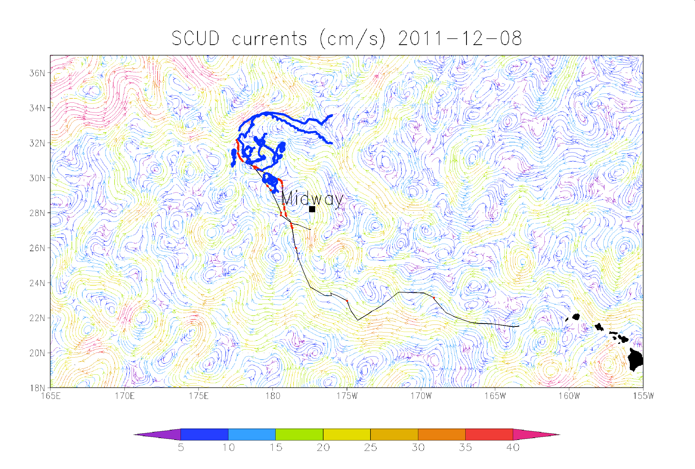
December 2011 expedition, co-organized by the University of Hawaii,
Ocean Recovery Alliance, and Scripps Institution of Oceanography

Slide 9
December 2011 expedition, co-organized by the University of Hawaii,
Ocean Recovery Alliance, and Scripps Institution of Oceanography

Slide 10
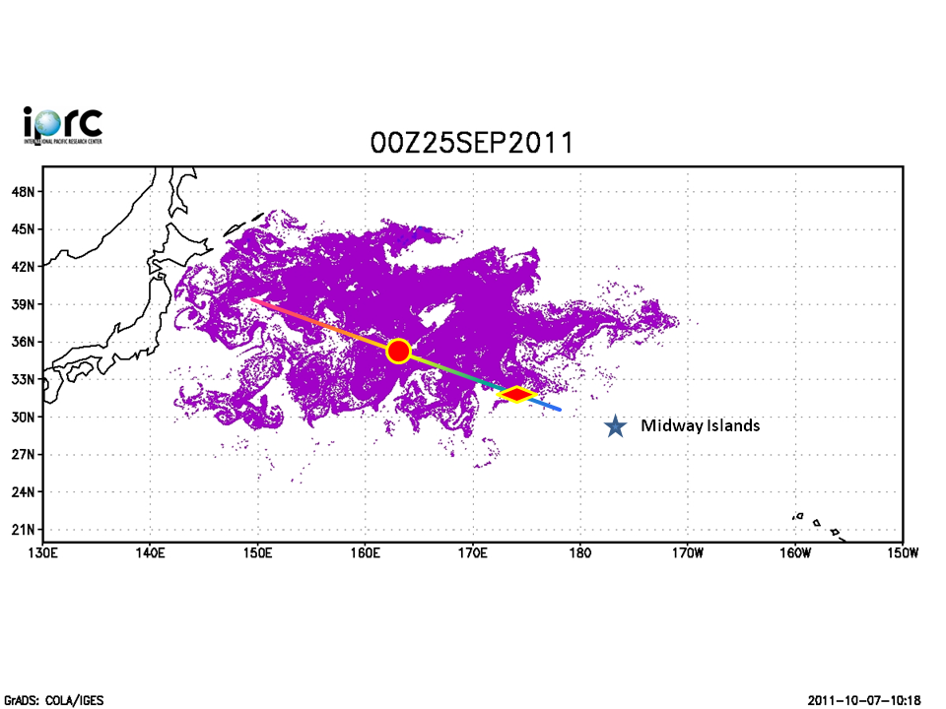
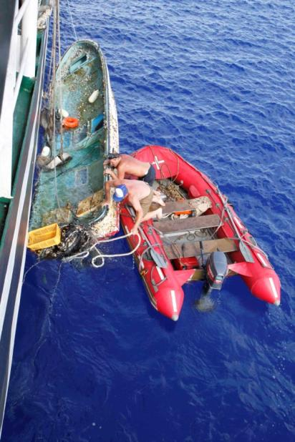
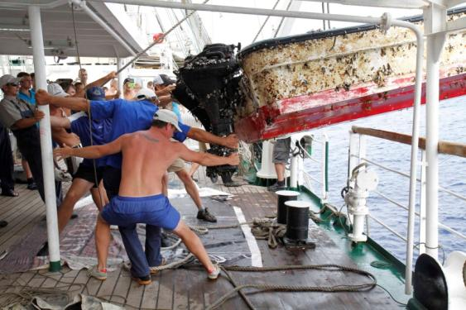
STS “Pallada” found tsunami debris where SCUD predicted
Small fishing boat,
registered in Fukushima
Prefecture
Observed maximum
density of debris

Slide 11
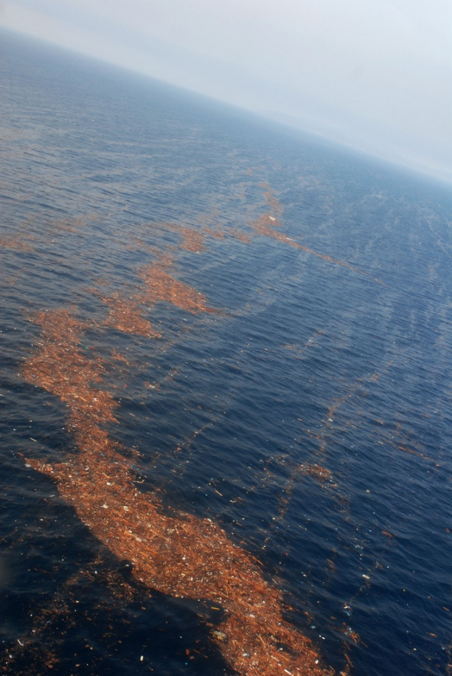
High concentration of
debris days after
tsunami
Courtesy of US Navy

Slide 12
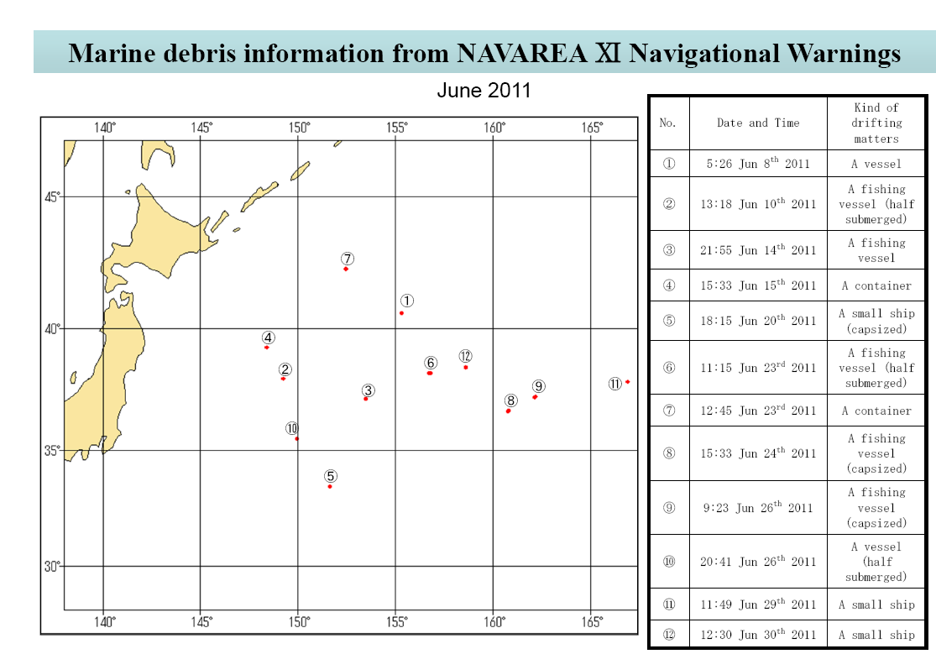
Prime Minister of Japan and His Cabinet:
http://www.kantei.go.jp/jp/singi/kaiyou/hyouryuu/senpaku_eng.html

Slide 13
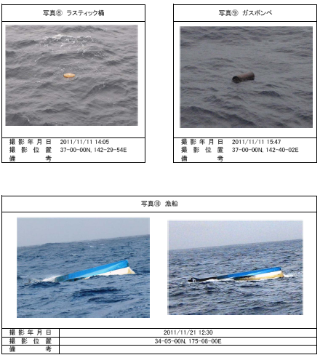
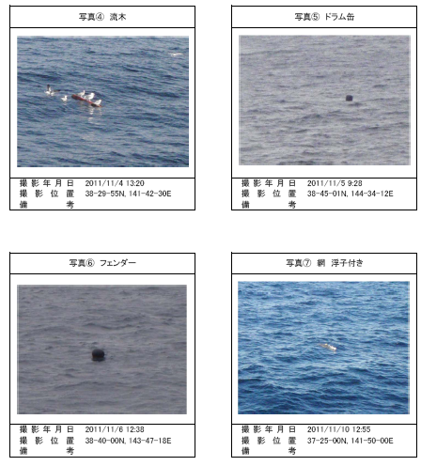
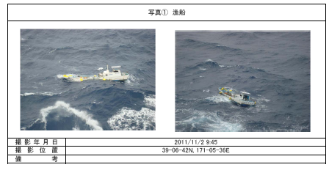
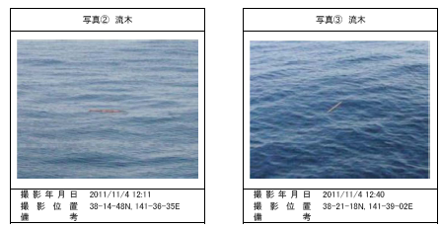
http://www.kantei.go.jp/jp/singi/kaiyou/hyouryuu/senpaku.html

Slide 14
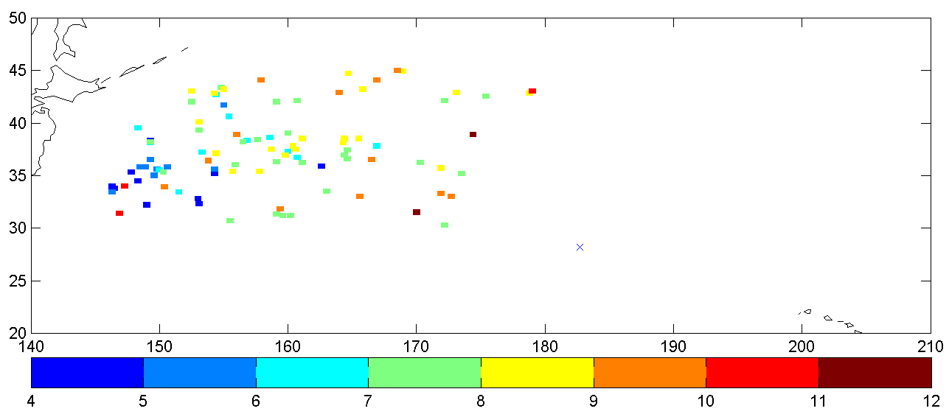
Sightings of tsunami debris in NAVAREA XI in different months
NAVAREA XI
Months
Based on the data from the webpage of the Prime Minister of Japan and His Cabinet: http://www.kantei.go.jp/jp/singi/kaiyou/hyouryuu/senpaku_eng.html

Slide 15
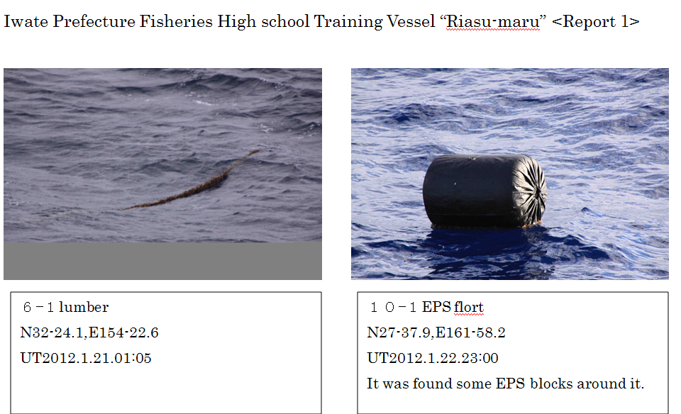

Slide 16
Fate of tsunami debris

Slide 17
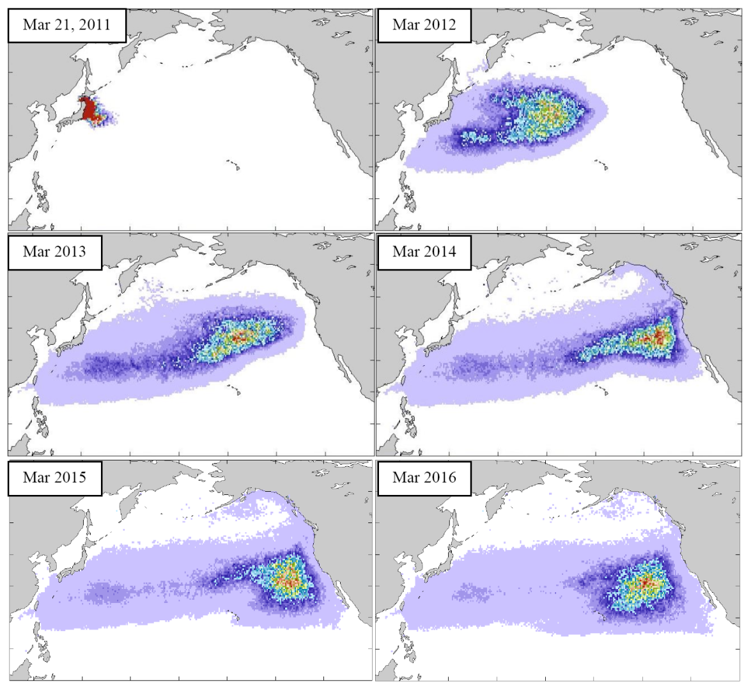

Slide 18
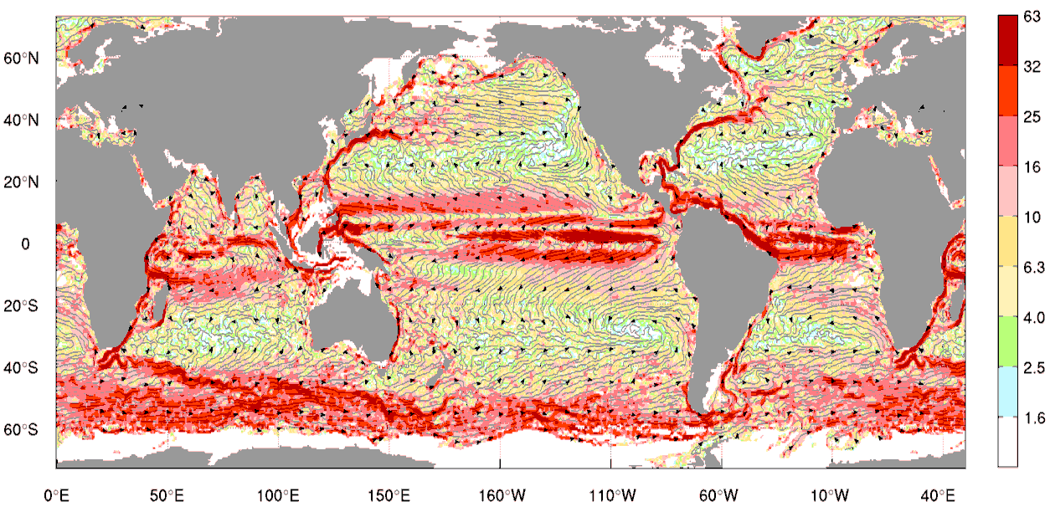
Mean streamlines of surface currents, derived from drifters

Slide 19
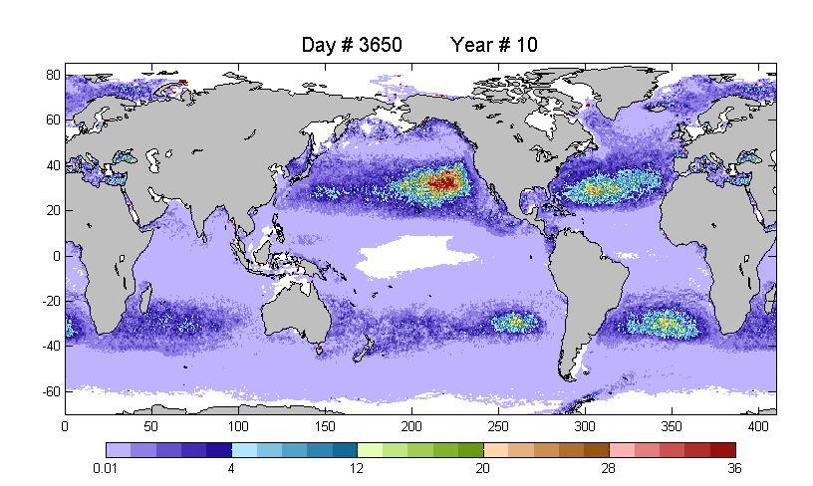
UH: Model debris distribution from coastal sources (without tsunami)
Collaborations with the SEA, “5 Gyres”, KAISEI/Ocean Voyages, Jim Mackey
et al. helped to validate accumulation of microplastic in all five subtropical
convergences

Slide 20
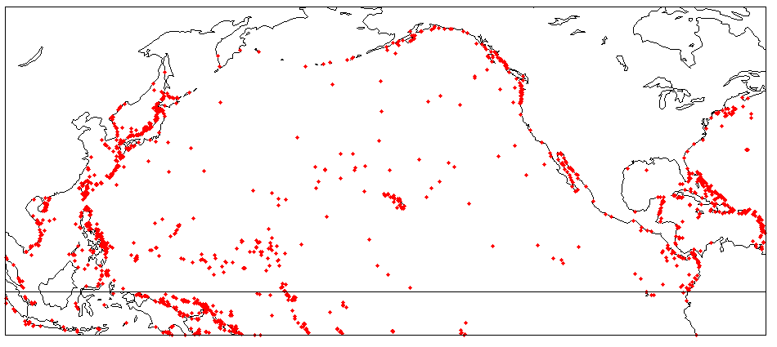
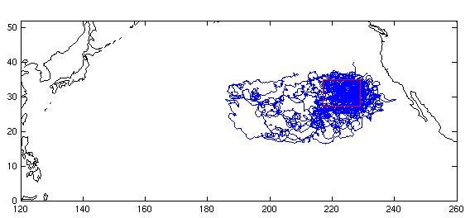
Sinks of debris in the North Pacific. Red dots show grounded drifters.
Hawaii is the final
destination for
marine debris,
collected in the
North Pacific
Garbage Patch.
Effect of tsunami
debris, mixed with
older plastic, on
Hawaii will
continue for many
years.
Trajectories of drifters starting from the
North Pacific convergence
16:02

Slide 21
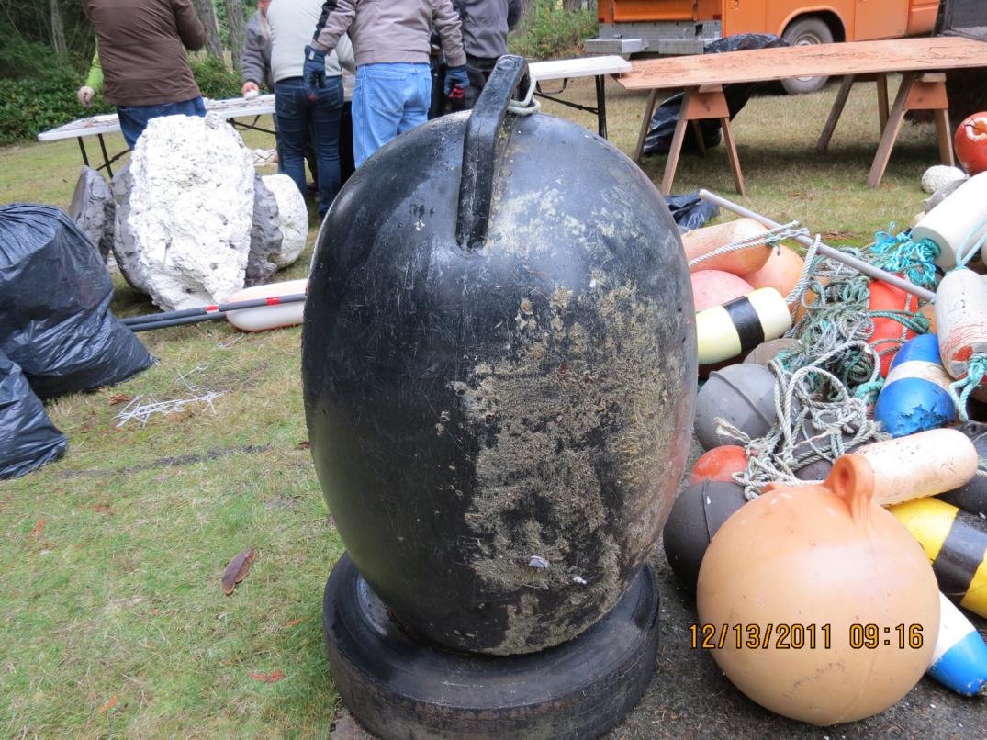
Suspected buoys from Japan, arriving on the US/Canada west coast
These large, light floats are mainly blown by wind, not carried by ocean currents.
Their drift is different from the drift of heavy objects, simulated by the models,
developed at the IPRC/UH. Their possible origin from the tsunami in Japan has
been confirmed by Japanese colleagues.
Photo courtesy of Curtis Ebbesmeyer

Slide 22
Probable characteristics and future fate of tsunami debris:
- 1-2 million tons of tsunami debris are still floating at the ocean surface
- density of debris is very low – two objects can hardly be seen at the same time
- only 1-5% percent of this amount will affect the coast line in the next
2-3 years, majority of the debris will drift to the Garbage Patch, where it will mix with common debris (having a budget of 2-4 million tons per year)
- tsunami debris will affect the same shores that are affected by the common marine debris (Alaska, British Columbia, Washington, Oregon, Hawaii)

Slide 23
Plan of action:
- protect the coast line and let ocean to grind the debris, remaining in water
- compute the paths (or “corridors”), taken by debris on its way to critical parts of the coast line; use these paths to monitor and intercept dangerous objects, mitigate impact of debris, and optimize the use of limited resources
- use this tragic “experiment of nature” to understand general dynamics of marine debris and to design the system, addressing the long-standing problem

Slide 24
Follow the progress of the IPRC/UH tsunami debris study at http://iprc.soest.hawaii.edu/news/marine_and_tsunami_debris/debris_news.php
Forward your inquiries to marinedebris@soest.hawaii.edu

